Slide 1
Csci465: Principals of Translations
Chapter 4: Syntax Analysis
Part 2: Bottom-up Parsing
UND School of Electrical Engineering and Computer Science
Dr. Hassan Reza

Slide 2
Objectives
Bottom up parsing
Shift-reduce parsing
LR Grammars: Simple LR or SLR
LR (0) Automaton
Reductions
Handles
Conflict During Shift/Reduce Parsing

Slide 3
Bottom up parsing
Bottom up parsing
Refers to the construction of a parse tree using an input string staring from the leaves (bottom) all the way towards the root of the tree

Slide 4
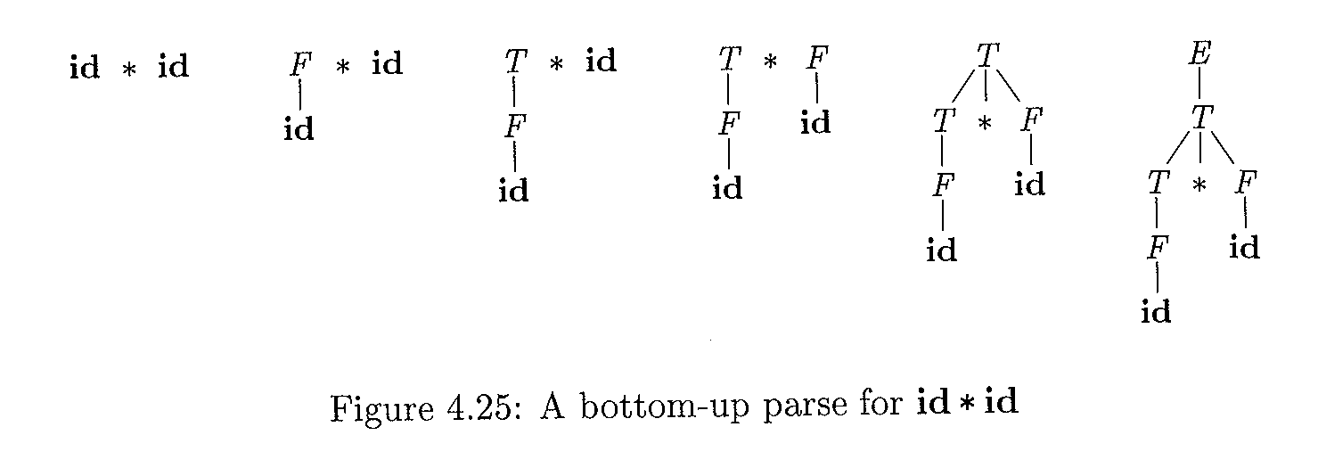
Bottom-up Parse construction: Example id*id
Sequence of parse tree construction:
Grammar G:
E→ E + T | T
T→ T * F | F
F→ (E )| id

Slide 5
Example
Consider the following grammar
S→aABe
A→Abc|b
B→d
Input: abbcde
Steps:
abbcde ⇒aAbcde⇒aAde⇒aABe⇒S
abbcde can be reduced to S (goal symbol)

Slide 6
Reverses Rightmost Derivation (rm)
Using Reverse Rightmost derivation starting from S
S⇒_{rm} aABe⇒_{rm} aAde ⇒_{rm} aAbcde⇒_{rm} abbcde
S→aABe
A→Abc|b
B→d

Slide 7
Handles
Handle?
The opposite of derivation
A substring on the R.H.S that can be replaced with the non-terminal on the L.H.S in the reverse process of rightmost derivation
Example
abbcde
aAbcde; b is the a handle at position 2
S⇒_{rm} aABe⇒_{rm} aAde ⇒_{rm} aAbcde⇒_{rm} abbcde

Slide 8
Example 4.23
Consider the following grammar
E→E +E
E→E * E
E→ (E)
E→id

Slide 9
Handle Pruning
Right-Sentential | Handle | Reducing Production
id₁ + id₂ * id₃ | id₁ | E→id
E+ id₂ * id₃ | id₂ | E→id
E + E * id₃ | id₃ | E→id
E + E * E | E*E | E→E*E
E + E | E+E | E→E+E
E | - | -

Slide 10
Shift-Reduce Parsing(SRP)
Shift-Reduce Parsing(SRP)
The Largest class of SRP known as LR
Builds a parse tree from leaves to the root
the process consists of as a set of reduction steps which eventfully replaces a string w with the goal symbol S
Reduction step?
A step that replaces a specific substring on the R.H.S with L.H.S
Example of Reduction process on id * id
id*id, F * id, T* id, T * F, E

Slide 11
A handle (revisited)
Refers to the sequence of symbols that resulted from the most recently expanded nonterminal.
s
A
α
β
ɯ
A handle A→β in the parse tree for αβɯ

Slide 12
SRP elements and process
Utilizes the stack and input buffer
Buffer holds the string to be parsed
Stack always holds grammar symbols
The handle (i.e., substrings of terminals and/or nonterminal) always located on the TOP of STACK

Slide 13
How SRP work?
SRP works as follows
Shifts input symbols* (i.e., zero or more) onto the stack until a handle β is found in stack
Reduces handle β to the L.H.S using an appropriate production rule
Repeats the process until
Error is found (i.e., no match), or
Goal Symbol(S) and end of input ($)are found

Slide 14
Stack Implementation of SRP
Two issues need to be addressed with handles
How to identify substring?
How to select the right production rule?
Let’s assume Initial state: Stack: $, Input: w$ Where
w is a string of input
$ is end of stack and input marker
Final state
Stack: $ S (goal symbol)
Input: $

Slide 15
(Example of SRP for id1+id2*id3)
stack | Input | Action
$ | id1 + id2 * id3$ | shift
$id1 | + id2 * id3$ | Reduce by E→id
$E | + id2 * id3$ | shift
$E+ | id2 * id3$ | shift
$E + id2 | * id3$ | Reduce E→id
$E+E | * id3$ | shift
$E+E* | id3$ | shift
$E+E*id3 | $ | Reduce E→id
$E+E*E | $ | Reduce E→E*E
$E+E | $ | Reduce E→E+E
$E | $ | accept

Slide 16
Primary Operations of Shift Reduce Parsing (SRP)
Main operations include
Shift s (s is the state)
Reduce by grammar production A →β
Accept
Error

Slide 17
shift action
Shift action?
Indicates that the current symbol should be pushed onto the stack and that the automata should transition to state X (e.g., state 5).
Notes:
shift state # (e.g., s5):

Slide 18
Reduce action
Reduce action
Parser knows the right end of the handle β is at the top of the stack
Parser needs to locate the left end of the handle β within the stack
Parser decides what non-terminal to replace for handle β

Slide 19
accept & error actions
Accept action
The parser announces successful completion of parsing
Error action
The parser discovers that syntax error has occurred
calls an error recovery routine

Slide 20
Potential Problems

Slide 21
Example (Shift/Reduce): Dangling Else
stmt→ if expr then stmt
| if expr then stmt else stmt
| others
Stack Input
… if expr then stmt else…$
Cannot tell if this is the handle

Slide 22
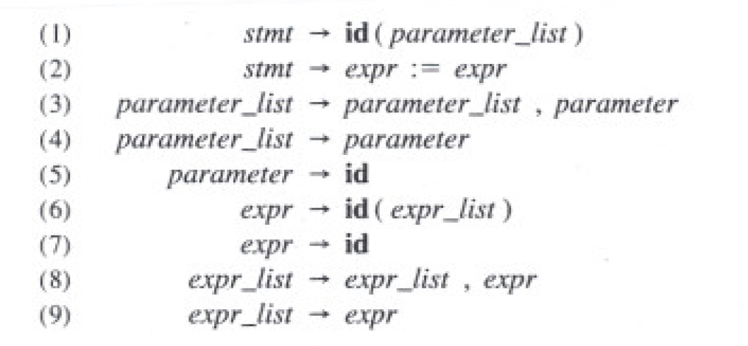
Example (reduce/reduce) conflict (procedure call or array)
Suppose we have a statement like A(I,J) using this Grammar:
?
?

Slide 23
Con’t: reduce/reduce conflict (procedure call or array)
After shifting the first three tokens onto the stack:
Stack Input
…id ( id ,id)…
Note: id is on the top of the stack, and it must be reduced;
The parser does not know which rule to apply:
rule 5 or rule 7?

Slide 24
Con’t: reduce/reduce conflict (procedure call or array)
One solution is to change the token id in p.1 to procid
Stack Input
…id ( id ,id)…
Stack Input
…procid ( id ,id)…
1
2

Slide 25
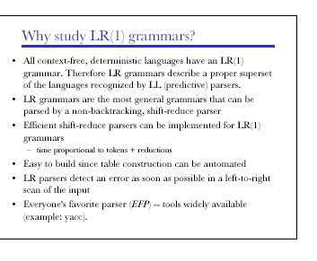
LR (1) Grammars

Slide 26
Final note on LR (k)
LR
More general and more expressive than CFG
The decisions are made at R.H.S of the rule using some or ALL part of the production
Uses more context than LL(k)

Slide 27
Problem with LR
Main drawback of LR
TOO much work to build an LR by hand
Need a tool, an LR parser generator (Yacc)
In case the handler is ambiguous, the tool can locate these issues by providing detailed diagnostic messages

Slide 28
How does SRP works
How does a SRP know what type of action should be performed?
Shift
Accept
Reduce
Error
For example, how does the parser know the symbol on the top of the stack is not handle and therefore the right action is to perform shift?
The parser makes the right decision (S, R, Acc, Err) by building an DFA in which the states keep track of where we are during the parsing

Slide 29
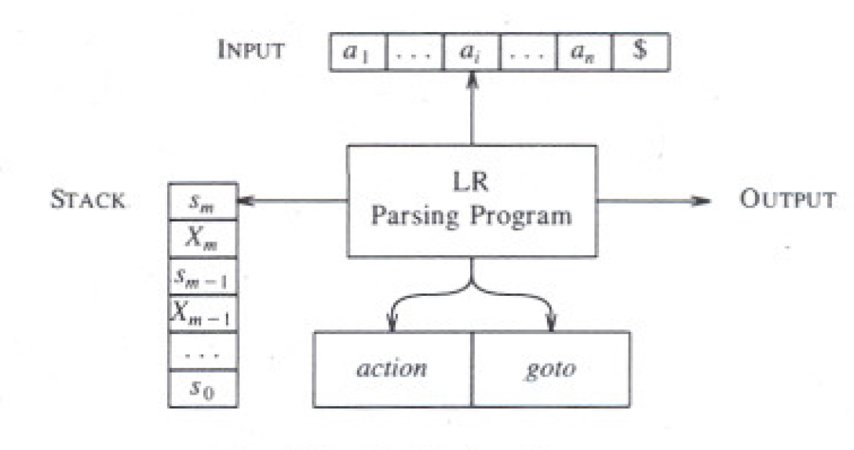
Model of LR Parsing
Reads Input from buffer
ACTION[I,a]= {Shift, reduce, accept, error}
Goto[S_{i},N_{i}]=S_{j}

Slide 30
LR Parsing Algorithm
To create an LR parser, we need to construct a Action-Goto Table
Row = states
Columns = terminals and non-terminals.
Table entry can have four possible values
Shift, Reduce , Accept, Error

Slide 31
Shift action
shift state #:
Indicates that the current symbol should be pushed onto the stack, which means the automata should move to next state represented by state #.
The state # is pushed onto the stack.

Slide 32
Reduce Action
Indicates the number of state/symbol pairs that should be popped from stack
The non-terminal that should be pushed back onto the input stream.
The table entry indicates r_{j,} the production number to be applied to reduce L.H.S to R.H.S

Slide 33
Accept & Error actions
accept:
Accept the input string as valid if there are no symbols left on the input
error:
The current state doesn't have a valid transition for the current input symbol, which means the input string is invalid!

Slide 34
Quiz

Slide 35
Model of LR Parsing

Slide 36
Building LR Parsing Table
How to build an LR parsing table for a given grammar?
If we can build a parsing table for any given grammar G, then G is said to be an LR grammar
To be an LR means
Left-to-right SRP that can identify handles on the top of the stack

Slide 37
Toward Building SLR Tables
The SLR Parsing table
Build the collection of Items from Grammar
Group items into sets
Map sets into the states of the SLR parser

Slide 38
An item of LR(0)
Item of a grammar G?
A production of G having a dot “.” at some position
dot?
Any symbols before “.” represents part of a production that has been seen at a given point
Any symbols after dot “.” represents part of a production that remains to be seen

Slide 39
Items

Slide 40
More on Items
Example: A→XYZ, items are
A→.XYZ
we are hoping to see substring deriving from XYZ next on the input)
A→X.YZ
we have seen on the input a string derivable from X and hoping to see a string derivable from YZ)
A→XY.Z
we have seen on the input a string derivable from XY and hoping to see a string derivable from Z
A→ XYZ.
it is time to reduce XYZ to A (i.e., the handle is found)

Slide 41
Canonical LR(0) Collection
Canonical LR(0) Collection
Refers to set of LR(0) items, which can be used as the foundation for building determinates finite automaton (DFA) where
Each set of items maps to the state of DFS
GOTO represent transitions

Slide 42
construction of the canonical LR(0) collection for a grammar
To construct the Canonical LR(0) Collection for a grammar G
Augment grammar G
Use two functions
Closure (I)
Generates more items to a set of items
GOTO (I, X)
Works as a transition in LR(0) automaton by moving the ‘.’ past the symbol

Slide 43
Augmented Grammar
If grammar G having a start symbol, then G’ is the augmented grammar for G with a new start symbol S’
G’→G (G’ is used to signal the successful parsing (stop!))

Slide 44
Closure of Item Sets?
Suppose I is a set of items, then CLOSURE (I) can be obtained by these rules:
Add every item in I to CLOSURE (I)
IF A →α.Bβ is in Closure(I) and B→q is a production, then add the item B→.q to Item I.
Repeat rule 2 until no more the new item can be added to closure(I) (See figure 4.31)

Slide 45
Example 4.40
If I is the set of one item {[E’→.E},
Then CLOSUE (I) contains the set of item I₀

Slide 47
How to compute Closure I₀
How to compute closure E’→.E ?
E’→.E
<by rule 1 add it because an E is right after the dot at R.H.S>
E→.E + T
E→.T
<by rule 2 add E productions with dots at the left end.>
Apply rule 2 for all productions related to T, and F, we get I₀

Slide 48
Complete set of Items
If I is the set of one item {[E’→.E]}, then closure (I) can be
E’→.E < by rule 1>
E→.E + T < by rule 2: if A →α.Bβ, then add B→.q >
E→ .T < by rule 2 >
T→.T * F < by rule 2>
T→.F < by rule 2>
F→ .(E) <by rule 2>
F→ .id <by rule 2>

Slide 49
Complete collection of All possible items using closure

Slide 53
GOTO Function (transitions)

Slide 55
Use of the LR(0) Automaton
The main idea behind Simple LR parsing is to build LR(0) automaton from the grammar where
States = Sets of Items
Transitions = GOTO functions
How LR(0) automata help with shift-reduce decision?
Being in state, say, j, perform shift on input ‘a’ if there is a transition on ‘a’
Else perform reduce using items in J

Slide 56
Example 4.43
Fig:4.34:The Parse of id*id

Slide 57
Architecture of LR Parsing

Slide 58
Algorithims:4.44: LR Parsing algorism
INPUT: An input string w and LR_Parsing Table
Output: If w is in L(G), perform the reduction steps of bottom-up parse for w; otherwise, an error indication
Methods: Initially, the passer has s₀ on its stack, and w$ in the input buffer.

Slide 60
Shift state 5 in stack

Slide 61
Reduce using Rule 6

Slide 62
Reduce using Rule 6

Slide 65
Example of Using parsing Table on id*id+id

Slide 66
Constructing SLR-parsing Tables
Assume Grammar G’
Build C = {I₀,I₁,…,I_{n}} for G’
Construct State i using I_{i}
The parsing actions for state i are determined as follows
If [A→α.aβ] is in I_{i}, and GOTO(I_{i}, a) =I_{j}, then action [I,a] = s_{J} (shift state j)
If [A→α.] is in I_{i}, then action[I_{i} ,a] = reduce A→a for ALL a in Follow(A) (assuming A is not S’)
If [S’→S.] is in I_{i}, then action[I_{i}, $] = accept
The goto transition for state I_{i} is build using non-terminal A: if goto(I_{i}, A)=I_{j}, then goto[I_{i},A]=J
All entries not defined by rule 2, 3 are made “error”
The initial state of the parser is the one constructed from the set of items containing [S’→S.]

Slide 67
Example 4.47: 1 (building table)
Let us build the SLR table for the augmented expression grammar ( see fig .4.13). Consider the set of item I₀ as follows:
E’→.E
E→.E + T
E→ .T
T→.T * F
T→.F
F→ .(E)
F→ .id

Slide 68
Example 4.47: 2
Consider I_{0 (state 0)}
The item F→ .(E)
Results transition: action [0, (] =s4
The item F→ .id
Results transition: action [0, id] =s5
No actions for other item

Slide 69
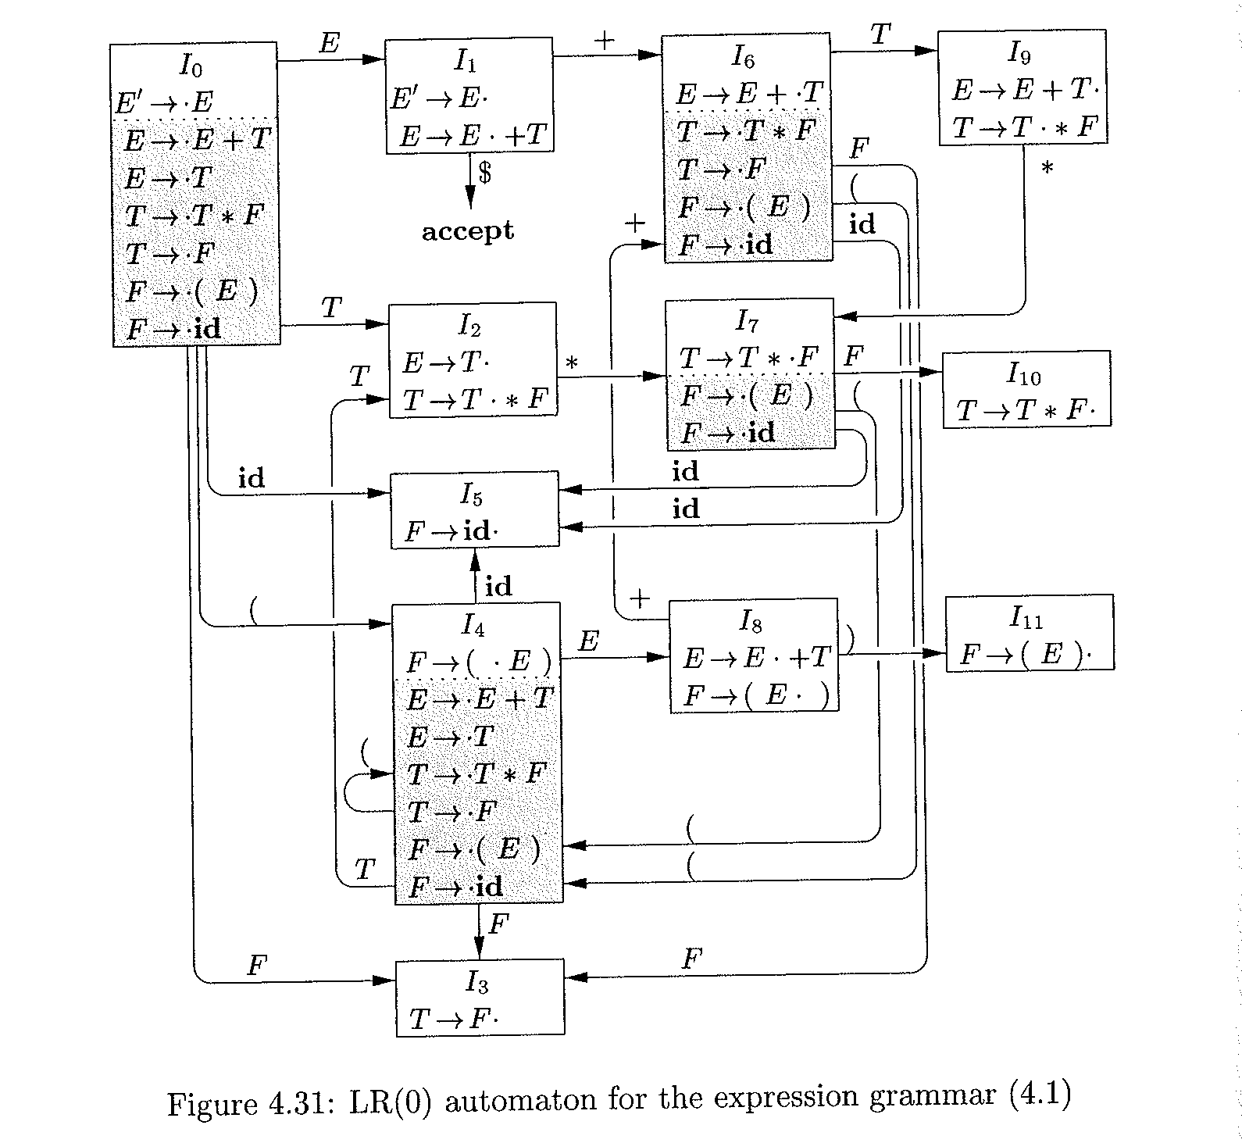

Slide 70
Fig4-31
Si :shift and stack state i;
Rj: reduce by production numbered by j
Acc: accept;
Blank: error

Slide 71
Fig4-31
Si :shift and stack state i;
Rj: reduce by production numbered by j
Acc: accept;
Blank: error

Slide 72
Example 4.38 (Reduce)
Consider I₂
E→T.
T→T.*F
Using this rule 3:
If [A→α.] is in I_{i}, then action[I_{i} ,a] = reduce A→a for ALL symbols of a in the Follow(A)
FOLLOW (E) = { $, +, ) } and E = E’ then
action[2, +,]=action[2, )]= action[2, $]=Reduce E→ T (i.e., Rule 2)

Slide 73
Fig4-31
Follow (E)= { +, ), $}

Slide 75
Second Item
I₂ makes
Action[2, *] = s₇

Slide 77
Fig4-31

Slide 79
Fig4-31
Si :shift and stack state i;
Rj: reduce by production numbered by j
Acc: accept;
Blank: error

Slide 80
Parser Generators; Yacc
A parser generator can be used to automate the construction of the front end of a compiler
Examples of the generator is
Yacc (yet another compiler –compiler)
About yacc
The first version created by S.C. Johnson in early 1970
Available as a command on the Unix system
Process using Yacc
Prepare a file, say, translate.y contains yacc specification
Use the Unix system command:
yacc translate.y // generate a C program called y.tab.c
CC y.tab.c –ly // compile it with ly library that contains the LR parsing program
More on how to use yacc: https://www.youtube.com/watch?v=__-wUHG2rfM

Slide 81
Advanced Topics
Optimizing a grammar
Reducing the size of LR(1) tables
Combining rows/columns
Shrinking the Grammar
Directly Encoding the table
Using better construction algorithms

Slide 82
Optimizing a Grammar
There is a correlation between number of productions rules and amount of work to parse
Top down Parser
Works with derivation
Bottom up Parser
performs a reduction for every single derivation

Slide 83
Derivation
Rewrite the grammar to shorten the height of parse tree because the shorter tree translated into
Shorter derivation
Shorter time to parse
Less reductions
Optimization has no effect on the behavior of parser!

Slide 84
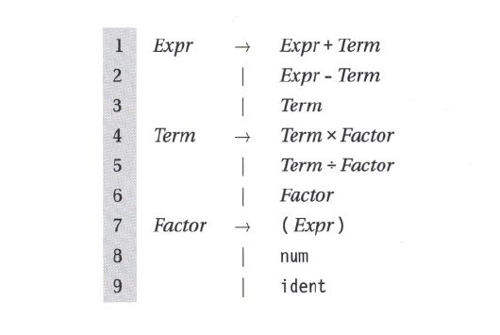
Example: Expression Tree

Slide 85
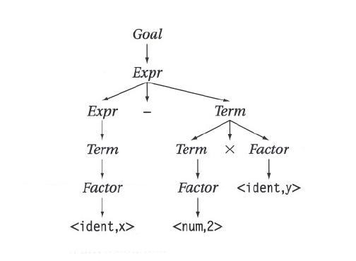
Parse Tree for Exp. Grammar
(x – 2 * y)
A node with a single child is a candidate for optimization

Slide 86
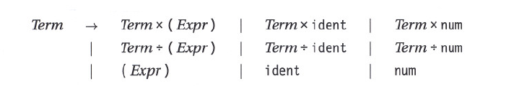
Revised Grammar
Obtain revised grammar by substituting for Factor by its alternatives
increases the # of alternatives for terms
Shrinks the parse tree by eliminating a layer

Slide 87
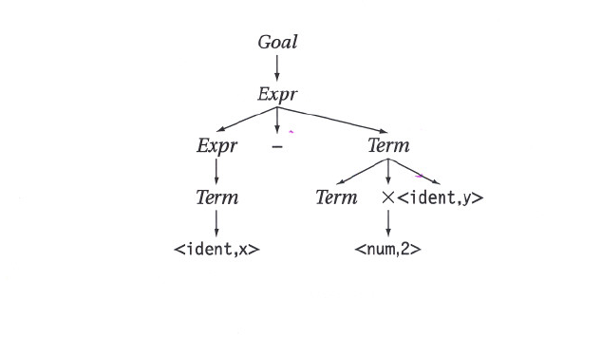
Revised Expression Grammar
(x – 2 * y)

Slide 88
General rule
Useless productions
Production having a single symbol on R.H.S
Used for performing a specific action
Fold away useless productions
Can increase the size of table in LR(1)
remove one columns while it may add many rows
Can increase the number of comparison in LL(1)

Slide 89
Reducing the size of LR(1) tables: Combing Rows/Columns
LR(1) generated for even small grammars can be large
Combining rows/columns results in a direct reductions in table size and an extra indirection to access the table
Need to understand the tradeoff

Slide 90
Combing Rows (or columns)
Find two identical rows (or columns)
Each set can be implemented by table generators once
Remap parser-state to row-index in action table
Same things for identical columns

Slide 91
Shrinking the grammar
To shrink the grammar
Reduce the number of production rules
Example
Factor→ num| ident ( * /)
Can be rewritten
Factor→ val
Action tables?
Removes a column from action table
Scanner must return val for ident or num
See the table

Slide 92
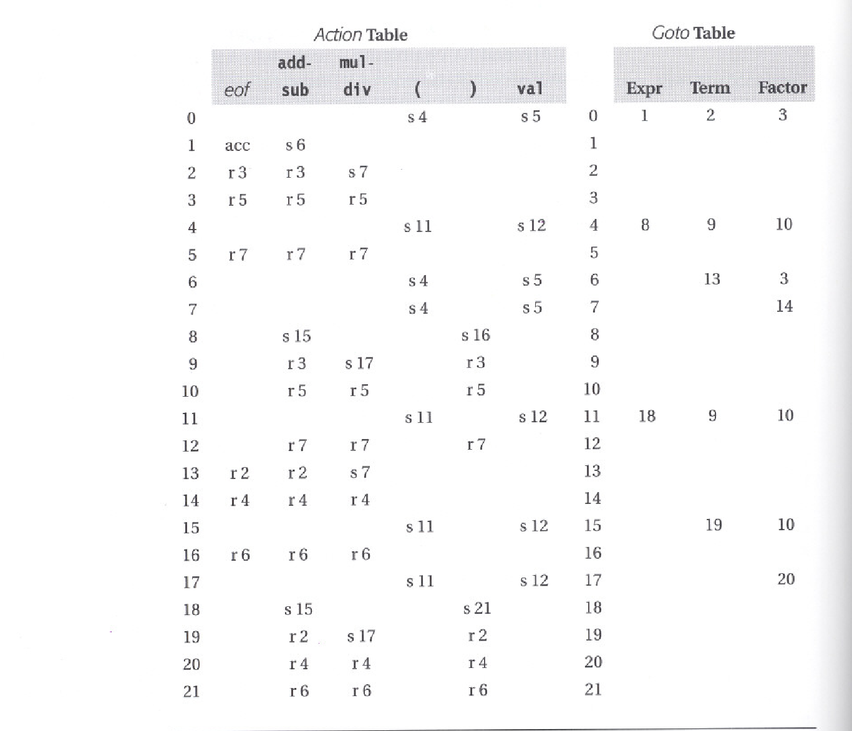

Slide 93
Directly Encoding the table
Forget about the table driven approach
Use hard-coded implementation
State is coded as case statement (IF-THEN-ELSE)
Test the type of next symbol
Perform
Shift
Reduce
Accept
Error
no table operations, no overhead (good)
No table lookup
Larger code size (bad)
Not readable (bad)

Slide 94
Using Other Construction Algorithms
LR(1)
The most general table construction algorithms
Produces the largest tables, but accepts the largest class of grammar
Is there other variation of LR(1) algorithms?
Simple LR(1) (or SLR)
Accepts smaller class of grammars than LR(1)
Uses FOLLOW set instead of Lookahead symbol to shift or reduce
FOLLOW set results in smaller tables
LookAhead LR(1) (or LALR(1) )
Works on the assumption that some items in the set (state) are critical that rest can be derived from them

Slide 95
Top-Down vs. Bottom up
Adv. of Top-down
Easy to build hand-coded parser
Provide excellent opportunity to detect/recover errors
Easy to find ambiguities
Faster (well-constructed ones!)
Adv. of Bottom-up
Tool support
Handles a lager class of grammars

